Slide 1
Parking Standards
<Event>
<Date>
<Location>
<Speaker>, <Organisation>

Slide 2
Definition of parking standards

Slide 3
Parking standards
Parking standards for new development regulate how much (car)parking space is built for new buildings
Parking standards were designed to instruct developers to build parking lots in correlation to
the amount of apartments (or size of apartments)
the amount of new offices/shops/workplaces etc.
Most countries have minimum requirements and building developers can build more if they want
Notes:
One of the fields of activities within the Park4SUMP Project is parking standards.
Parking standards are also known as parking requirements or parking norms.
In this training material we focus on parking standards for new developments.
New development is a broad term. It refers to new residential areas, but also to areas with mixed use of residential and commercial space, which is increasingly the focus of new urban expansion projects. Purely commercial areas are not discussed in greater detail for reasons of complexity

Slide 4
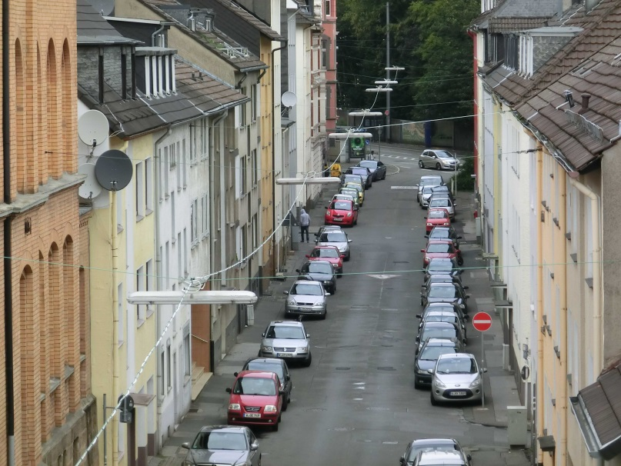
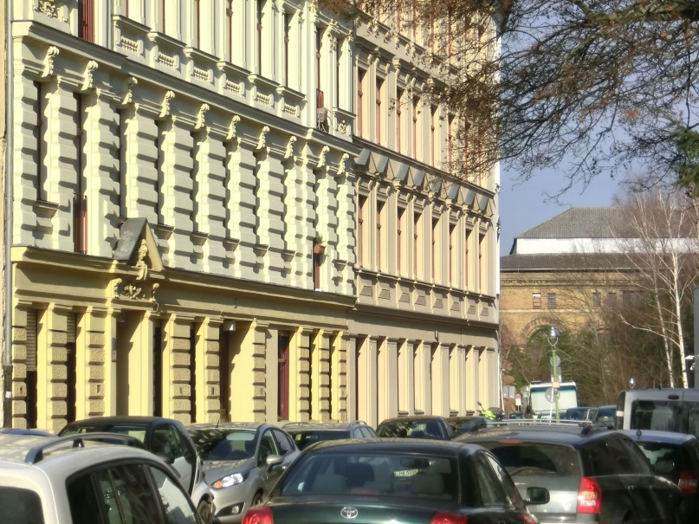
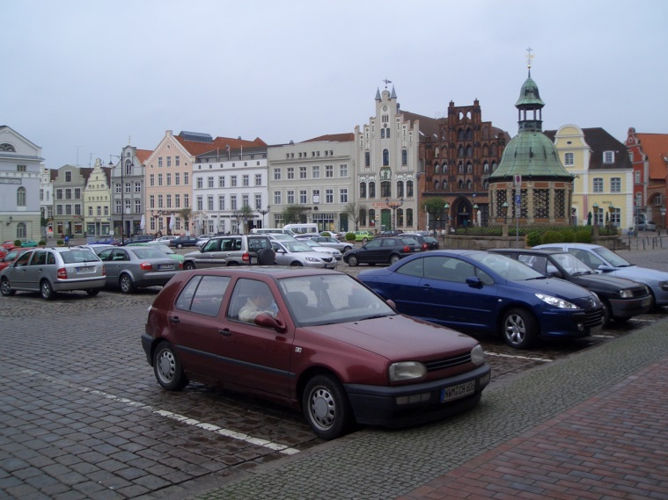
Parking standards
Parking standard have been introduced
to keep the streets free for the flowing traffic
prevent that a (new) location - office building, new housing, new shopping mall - generates parking problems in its neighboorhood
© Jürgen Gies
© Jürgen Gies
© Martina Hertel
Notes:
European cities were not built for cars so all new buildings and all new developed areas had to provide sufficient off street parking space. Each new apartment should have its ‘own’ parking space. Office buildings, shopping centers and other points of interest (restaurants, cinemas, sports locations etc.) should provide enough parking spaces for customers, deliveries and employees. The idea was to keep the streets free for the flowing traffic and “prevent that a (new) location, for example an office building, generates parking problems in its vicinity, for example residential areas” (Mingardo 2016: 16).

Slide 5
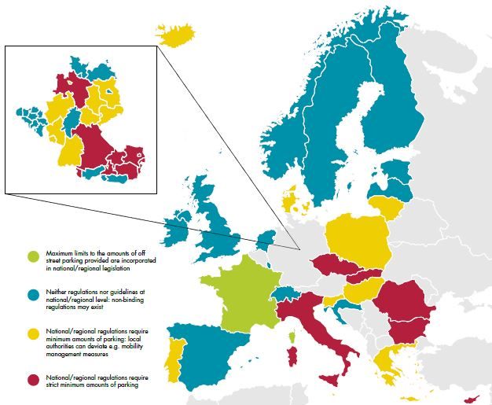
Parking standards
The most frequent parking standard is one car parking space per apartment / residential unit
In rural and suburban areas the parking standard is often even higher: 1,5
Source: Küster, F. and Peters, M. (2018): Making buildings fit for sustainable mobility – Comparing regulations for off-street bicycle and car parking in Europe. European Cyclists’ Federation. p. 27
Notes:
So, the parking standards were fixed in local, regional or sometimes national regulations in a number of European countries. The most frequent rule was and still is “one car parking space per apartment”. In rural and suburban areas the rule was and still is much higher: Especially housing has the requirement for 1.5 cars per living unit in average.

Slide 6
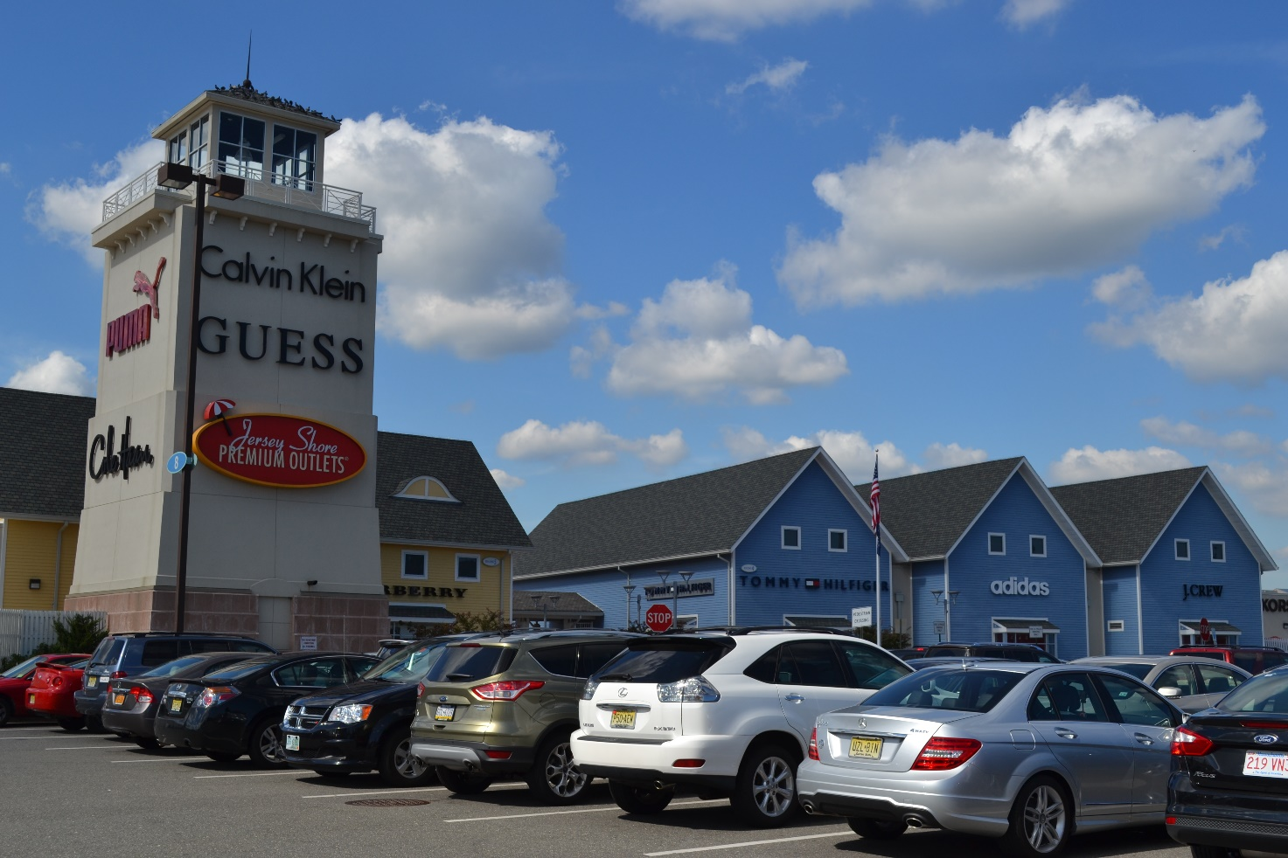
Parking standard for non-residential development
Regulations for malls, business areas, recreation areas etc. vary significantly
© Martina Hertel

Slide 7
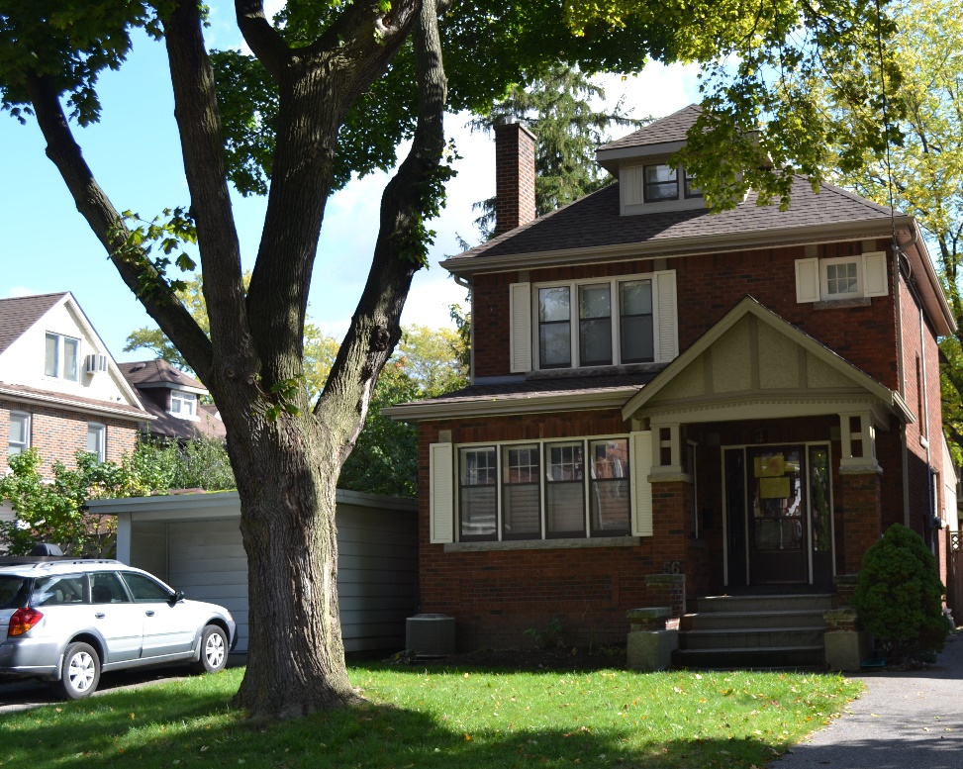
But…
Car parking availability induces car ownership and car use – it creates or attracts traffic
Studies show that the
availability,
location,
distances and
comfort of parking spaces influence the attractiveness of private car use
© Martina Hertel
It may lower the attractiveness of active transportation modes as cycling and walking and the use of public or shared transportation

Slide 8
Background information

Slide 9
Choise of transport mode going to work
Source: „Österreich unterwegs 2013/2014.“ BMVIT 2016

Slide 10
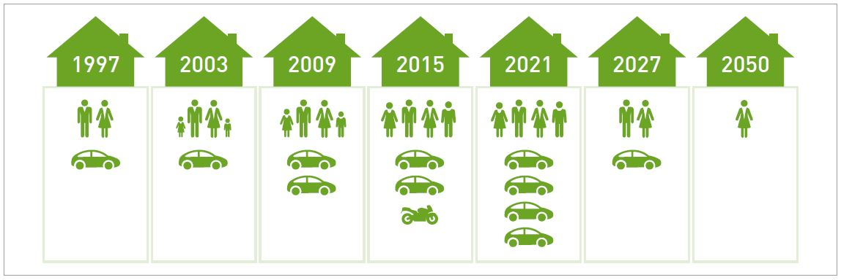
But how much parking space is enough?
Parking space requirement in the life cycle of a residential building changes over time
What’s the best ratio?
Source: „Kommunale Stellplatzsatzungen - Leitfaden zur Musterstellplatzsatzung NRW“ Seite 17
Notes:
The typical life cycle of a family implies differences in car ownership. As soon as children are in the house, for example, a car is purchased for the first time. If only one parent works one car may be enough. If both parents are going to work, two cars may be necessary depending on the location of the workplace. Children may get their own car. After the children move out and the parents are retired, there may again be no car in the household. The right number of parking spaces for each apartment is therefore not easy to determine, which is why flexible solutions such as neighborhood garages are becoming increasingly important. The figure shows a typical life cycle of a family.

Slide 11
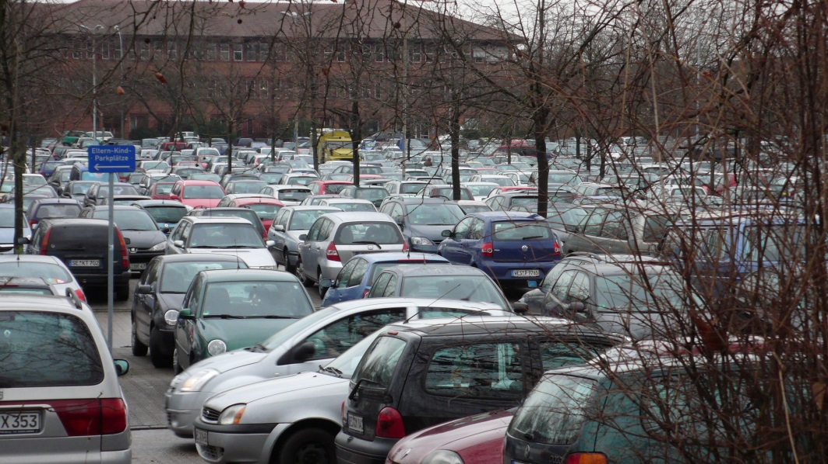
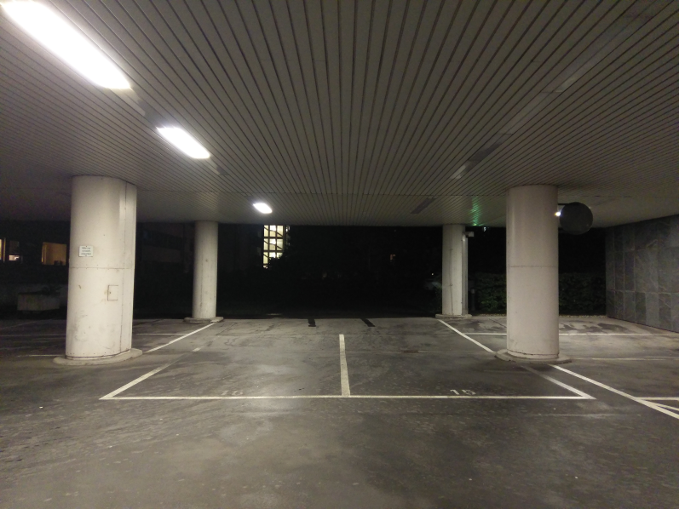
High parking standards are expensive
Building costs per parking space (including cost for access) depending on property costs based on empirical values
© Martina Hertel
© Jörg Thiemann-Linden
© Martina Hertel
~Up to 3.000 €
~5.000 € to 20.000 €
~20.000 to 72.000 €
Plus: Annual operating costs between 2 % and 8 % of the building costs
Notes:
High requirements to build the fixed standards affect construction and maintenance costs of (new) buildings, created land use conflicts and severe environmental problems. Most countries have so called “minimum requirements” , but building developers can build more if they want. Fix maximum car parking allowances are limiting how much parking is provided in new building in order to reduce costs and deal with all other named problems.

Slide 12
Parking garages as solution?
Unfortunately the construction of underground garages usually has to be co-financed by all tenants or residents!
Trapped ….for paying others bill
An underground parking space in a typical apartment building in urban areas has buildings costs on average between 22,000 and 26,000 euros.
The underground car park accounts for about 10 percent of building construction costs, which are usually spread over all residents. It does not play any role, how whether they own a car or not.
Source: „Umparken – den öffentlichen Raum gerechter verteilen
Zahlen und Fakten zum Parkraummanagement“, Agora Verkehrswende, 3. aktualisierte Auflage 2020

Slide 13
Not every resident has car…!
…especially low income households sometimes are not able to finance a car, but have to co-financed the building cost of parking spaces
Source: „Mobilität in Deutschland.“ Kurzreport. BMVI (2017)

Slide 14
How to deal parking standards in future
High requirements to build the fixed parking standards affected construction and maintenance costs
Induced car use creates land use conflicts and severe environmental problems. Three options for municipalities – if regulated on local level – to act:
Abolish the parking standard (no minimum requirement for car parking) in order to reduce building costs
Give the legal chance for developers to lower the minimum requirement for car parking if alternatives are available, for example due to good public transport accessibility
Fix maximum car parking allowances – limiting how much parking is provided in new building

Slide 15
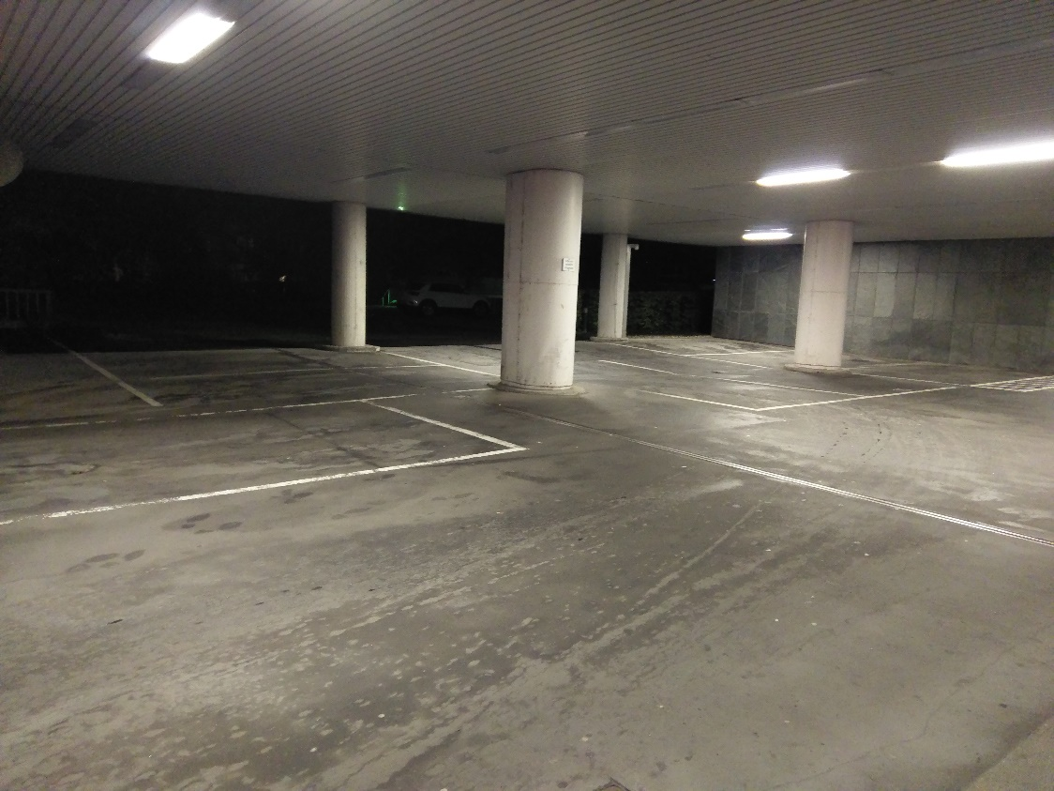
a. Abolish the parking standard (no minimum requirement for car parking) in order to reduce building costs
No required car parking standards for new housing
in Berlin and Hamburg – introduced in the mid 1990ties…
© Martina Hertel
=> No success: As many parking spaces as usually required were built ….in Berlin a maximum allowance would have been better

Slide 16
b. Lower the minimum requirement for car parking if alternatives are available
Give the legal chance for developers – in a regulation - to lower the minimum requirement for car parking if alternatives are available due to
excellent availability by public transport (called „PT bonus“)
shared mobility options as carsharing, bike sharing, cargo bike sharing etc.
high quality bike parking facilities
an advanced mobility concept
=> Absolute necessary precondition (mandatory requirement) for lower requirement is paid or regulated parking areas for on street parking for the area and the nearby areas

Slide 17
Good practice for lower parking requirements

Slide 18
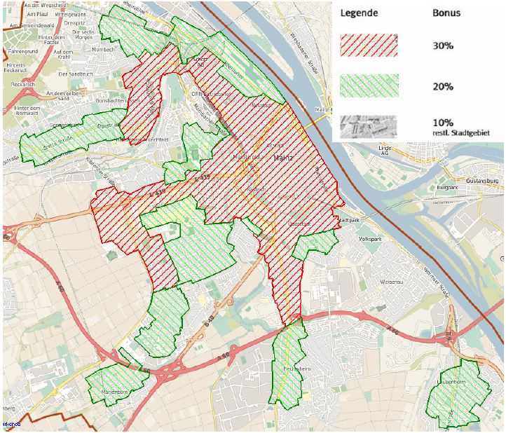
b. Lower the minimum requirement for car parking if alternatives are available… ….due to public transport bonus
Good practice in the City of Mainz:
The regulation is lowering parking space requirements by percentage if good public transport is given and therefore contributes to reduce construction costs
Source: https://bi.mainz.de/vo0050.php?__kvonr=16807
Notes:
Since 2015, the city of Mainz has been making use of the extended scope of action that the Rhineland-Palatinate State Building Regulations give the municipalities for determining the nec-essary number of parking spaces for new construction projects. The parking space statutes de-fine a public transport bonus based on the quality of access. The public transport bonus is used to divide the city area accordingly. This regulation is intended to take account of the actually lower parking space requirements with good public transport connections, and at the same time to contribute to reducing construction costs.

Slide 19
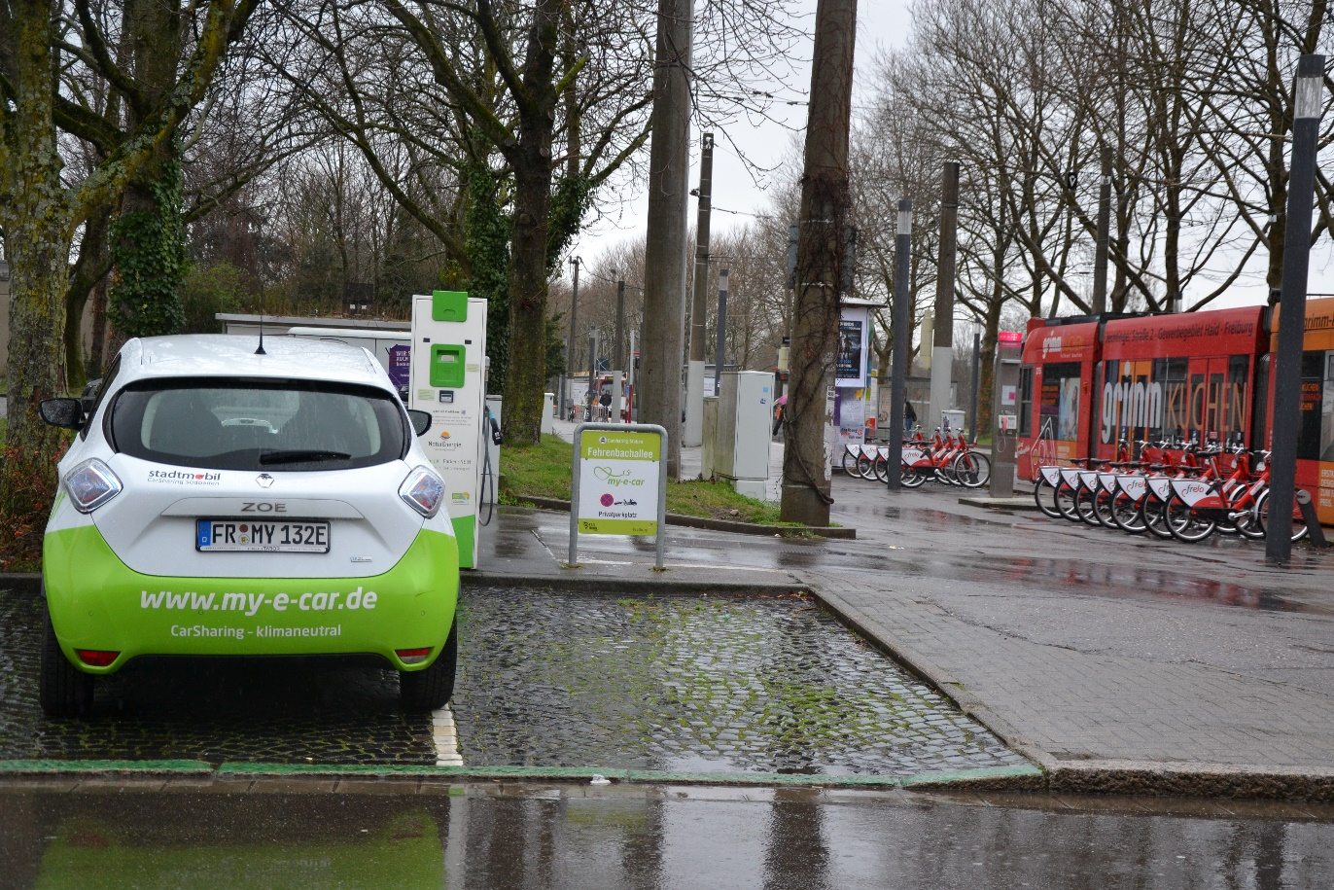
b. Lower the minimum requirement for car parking if alternatives are available…
... due to shared mobility options as carsharing, bike sharing, cargo bike sharing etc.:
Good practice in the City of Freiburg:
Mobility hub next to housing and technical town hall
© Martina Hertel

Slide 20
b. Lower the minimum requirement for car parking …due to high quality bicycle parking facilities
Mandatory provision of bicycle parking spaces!
Installation of front wheel holders, so-called rim killers, not permitted for new construction projects
Bicycle parking areas must offer a safe stand, be easily accessible and adequately lit
The number of bicycle parking spaces to be built depends on the type of building use (→ indicative number table)
Reduction of the parking space obligation (passenger car) through measures in the area of bicycle traffic promotion such as the provision of load bikes, roofing or lock-in facilities for bikes, lockers for charging pedelec batteries etc.

Slide 21
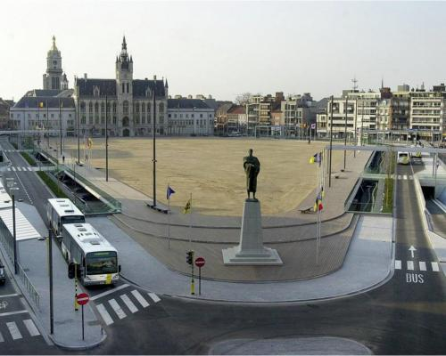
b. Good bicyle parking standards
Good practice in Sint Niklaas:
1 bicycle parking space per pillow, but 1 parking space per residential unit
Good practice in France:
maximum standards for car parking and minimum standards for bike parking apllies for rental housing with financial help
© Park4SUMP
Notes:
Considering the optimal traffic policy differentiation between maximum standards for car parking and minimum standards for bike parking is France the only jurisdiction that scores highest marks for both categories. But it should be noted that this maximum car parking policy only applies to rental housing financed with a loan assisted by the state as well as certain types of developments providing accommodation for the elderly and for university residences (Küster / Peters 2018: 29).

Slide 22
b. Reduction of parking space requirements due to CarSharing
City | New construction project | Reduction of parking standards for new developments | costs
Munich | Multi-generational living with 120 residential units in Munich CarSharing partner: STATTAUTO Munich | Reduction of parking standards by local authority because of CarSharing station: 0.5 instead of 0.8 | Reduction in construction costs (underground car park): approx. 300,000 euros, of which approx. 150,000 euros cannot be refinanced through parking space rentals
Source: Presentation by Gunnar Nehrke, lecture on 14 November 2019, Difu Seminar
© Martina Hertel
Source: https://www.stattauto-muenchen.de/renault-zoe/

Slide 23
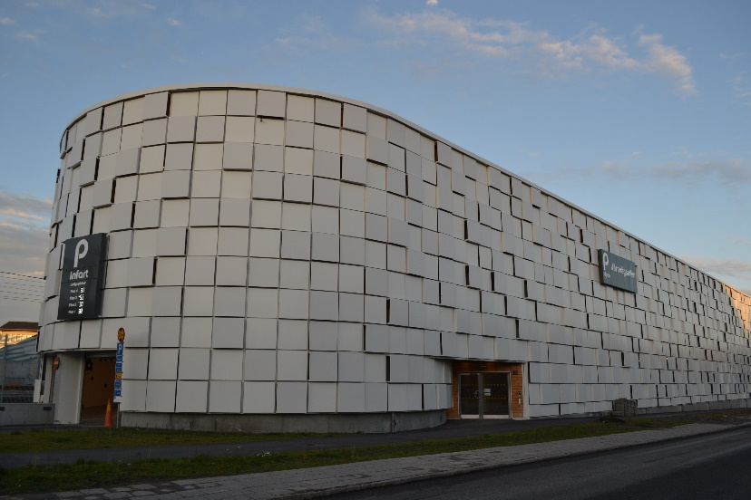
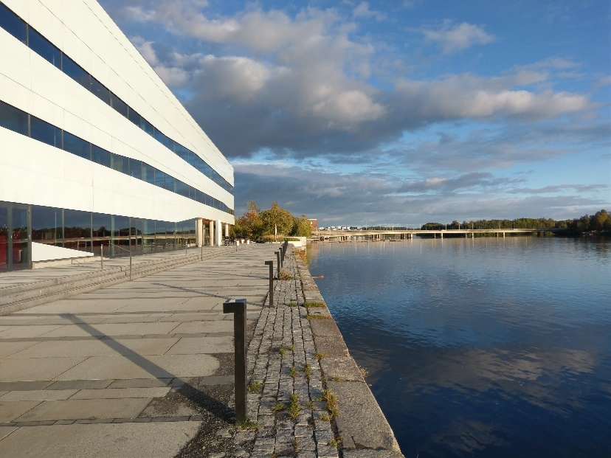
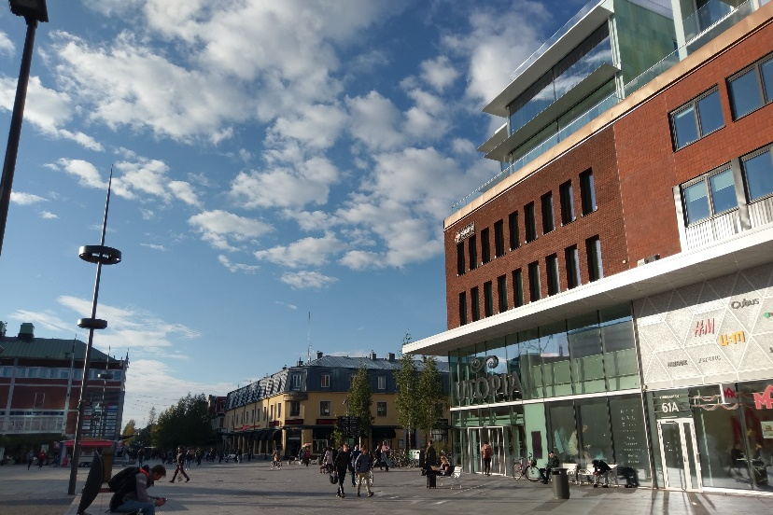
b. Good practice in Umeå: In the Green Parking Payoff project, property developers provide sustainable mobility services in exchange for lower parking requirements
© Martina Hertel
All photos by Martina Hertel
Notes:
In the Green Parking Payoff project, property developers provide sustainable mobility services in exchange for lower parking requirements. Examples of services are: provision of bicycle facilities such as service stations and dressing rooms; facilitation for carpooling, and; allocation of resources to a mobility management fund.
Umeå is one of Sweden’s fastest growing cities. This creates several challenges linked to urban development e.g. air quality deterioration and urban sprawl.
Based on an agreement between the City, the city parking company and property developers, the number of employee parking places on commercial properties can be reduced. forecasts show that the full potential of the project is a 41 % shift from car to more sus-tainable transport modes at real estate level. The project aims at creating a clear win-win situation for Umeå, the real estate owner and the environment. So far the project has been a success and has been extended to incorporate more property developers including Umeå Municipality.Umeå Municipality wants to set a good example by participating in the Green Parking Payoff.
A rebuilt City Hall will result in 40 % fewer parking places than would otherwise have been requested. The following website explains the initiative: http://www.eltis.org/discover/case-studies/umeas-green-parking-purchase-model-sweden

Slide 24
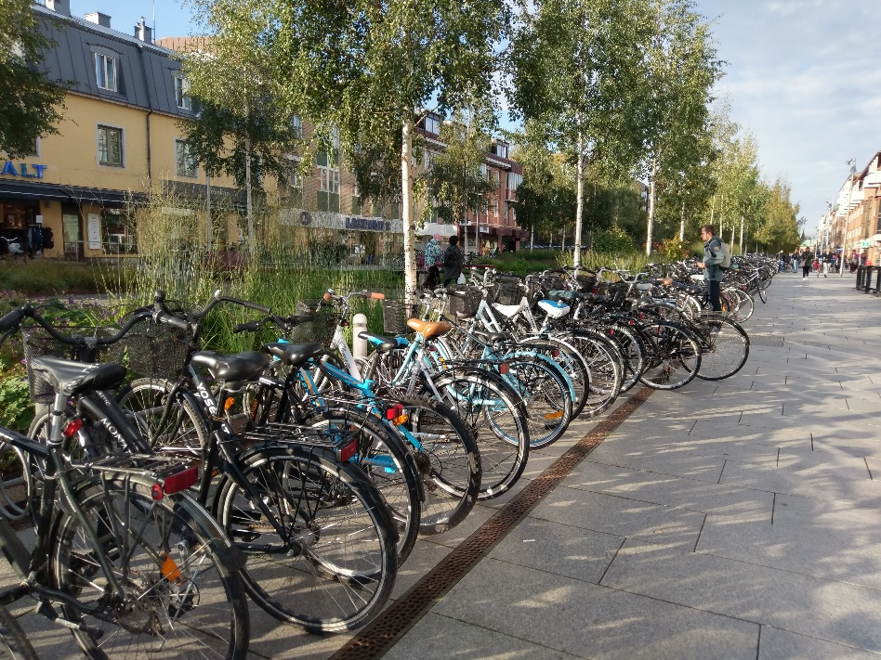
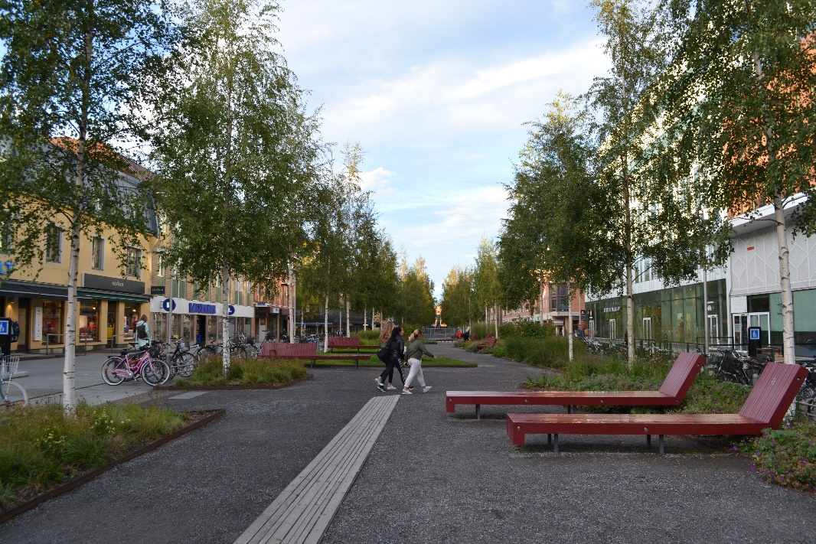
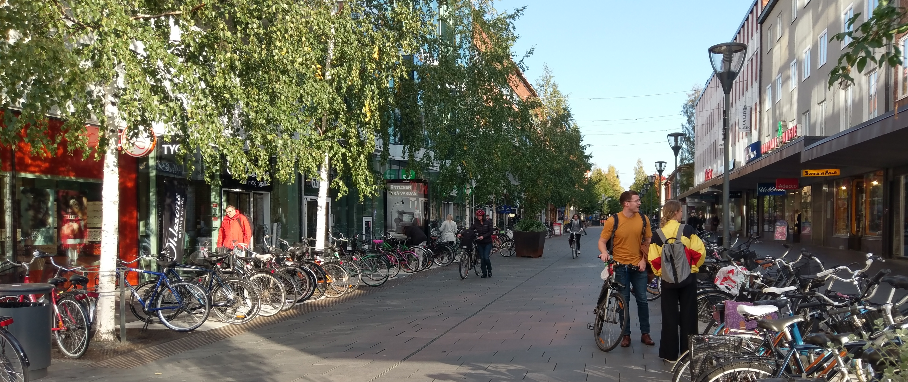
b. Good practice in Umeå: Lower the minimum requirement for car parking…. due to an advanced mobility concept: Green parking payoff
Foto: Martina Hertel
All photos by Martina Hertel
Notes:
A new bicycle parking establishment with a service station will be built and employees are encouraged to walk, cycle, take public transport or carshare. As a further development of the Green Parking Payoff, Umeå is examining the possibility of extending the project to include residential parking as well. This poses a greater challenge than workplace parking, but at the same time offers a greater impact on traffic and land use in the city.

Slide 25
Good practice on fix maximum car parking allowances

Slide 26
c. Fix maximum car parking allowances – limiting how much parking is provided in new building
Best practice in the City of Zurich: most advanced approach of maximum parking standards for housing
Zurich's 1996 historical compromise consisted of capping parking in the city centre at the 1990 level, with each new car park to be built replacing, on a 1:1 basis, the above-ground car parks that covered most of the city's squares at the time.
In 1996, the parking limits were adjusted to make them even more restrictive. Gradual changes over time formed the basis for the current parking policy in Zurich, which was ratified by the population in a referendum in 2010:
Area | Allowed parking space
City centre | Only maximum parking allowance 0.08 parking spaces per 92.903 $m^{2}$
Secondary centres outside the city centre | Minimum parking allowance is 0.30 spaces per 92.903 $m^{2}$ | Maximum is only 0.50 spaces per 92.903 $m^{2}$
Notes:
In 1996, the parking limits were adjusted to make them even more restrictive. These gradual changes over time formed the basis for the current parking policy in Zurich, which was ratified by the population in a referendum in 2010:
Under this new system, there is a standard parking level for the entire city, which is then reduced depending on whether a particular location is well connected to the public transport network or not.

Slide 27
c. Fix maximum car parking allowances – limiting how much parking is provided in new building
Good practice in Zurich: A map shows the areas and the required reduction for these areas:
Minimum in % |  | Maximum in %
Area A (Old Town) | 10 | 10
Area B (City) | 25 | 45
Area C (areas close to the city-centre and the centres Oerlikon, Altstetten and Höngg) | 40 | 70
Area D (Belt areas as well as Altstetten, Oerlikon, Seebach, Stettbach and the centres of Wollishofen, Affolter and Schwamendingen) | 60 | 95
remaining Area | 70 | 115
Regulation on private vehicle parking spaces : the number of minimum required and maximum permitted private parking spaces for cars is described in percentage of the “norm” parking standard – depending on the access quality by public transport. The norm parking is 1 parking space per 120 $m^{2}$

Slide 28
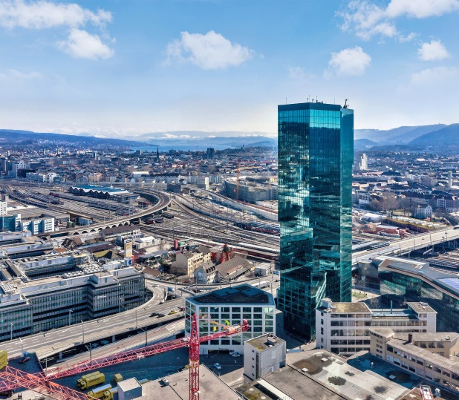
c. Fix maximum car parking allowances – limiting how much parking is provided in new building
Good practice in Zurich: Prime Tower complex at Zurich's Hardbruecke railway station:
The complex was opened in 2011 with a total of only 250 parking spaces,
With over 65032,128 square metres of lettable space,
the car park is provided by a ratio of only 0.35 spaces per 92,903 squaremeter
Source: Prime Tower CH

Slide 29
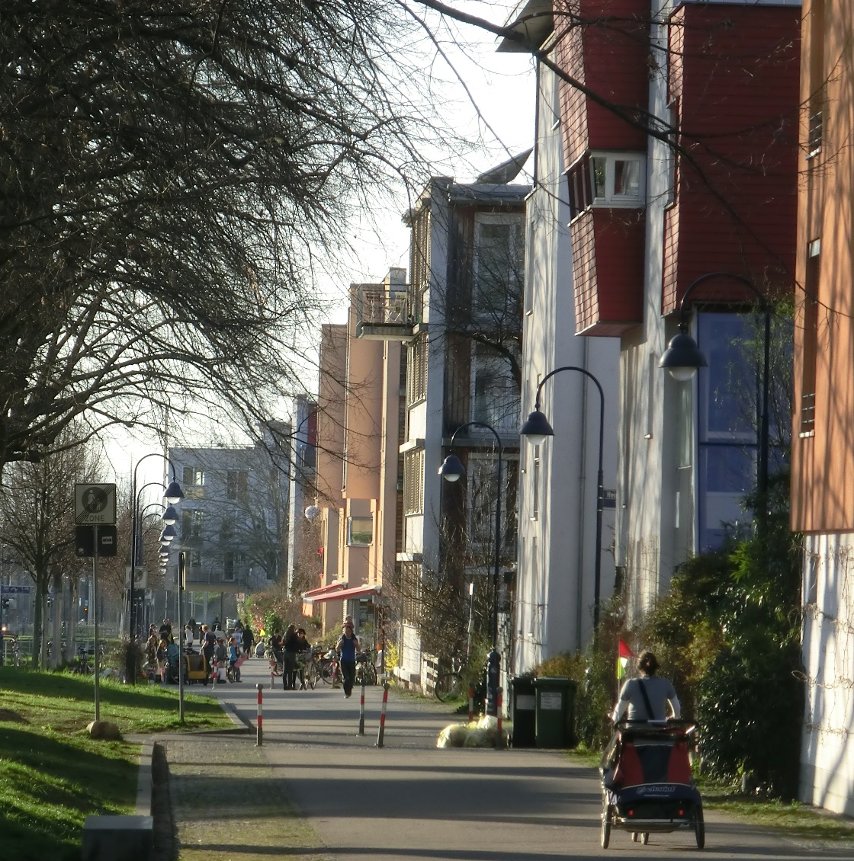
c. Limiting how much parking is provided in new building
Good practice in Freiburg – Vauban:
Vauban is a neighborhood for about 5.600 inhabitants that was completed in 2006
Parking was separated from living spatially and in terms of financial burden.
Parking spaces were only offered at actual cost without cross-subsidisation from house building and were realized in the form of multi-storey car parks (high garages) on the edge of the Vauban
© Jürgen Gies
Notes:
Vauban is still regarded as a model for a new urban quarter based on sustainability criteria. The traffic concept focuses on the use of parking space. Parking was separated from living not on-ly spatially but also in terms of financial burden. Parking spaces were offered at actual cost without cross-subsidisation from house building and were realised in the form of multi-storey car parks (high garages) on the edge of the Vauban neighbourhood. Vauban limits the number of parking spaces and separates them spatially from most of the residential units. However, driving on residential streets for loading and unloading is allowed. There are no public parking spaces in the residential streets and no parking spaces on private property. Residents of streets without parking spaces must purchase a parking space in one of the two car parks on the edge of the district. Along the main development axis (Vaubanallee and others), parking space is managed. This is also where some of the vehicles of the car-sharing providers are lo-cated.
Most of the residential complexes along Vaubanallee have no parking spaces, car owners must park their cars in one of the two car parks at the edge of the quarter. Residents who want to live there without a car must sign a declaration to this effect that they will not purchase a car. However, an area will be reserved to allow for an extension of parking in another private garage in the neighbourhood if necessary. Residents without a car finance this area with a one-off payment of 3,500 Euro. An association for car-free living was founded to administer the sys-tem.
The extension of the Freiburg tram to Vauban was put into operation in 2006. It connects the district with the city centre and the railway station in only 15 minutes. The integration into the cycle path network is also important for mobility.
With the greatly reduced construction of parking spaces and the separation of the costs of liv-ing from those of parking the car, Freiburg made progress at the time. Vauban gained interna-tional attention as a result. The concept still works today.

Slide 30
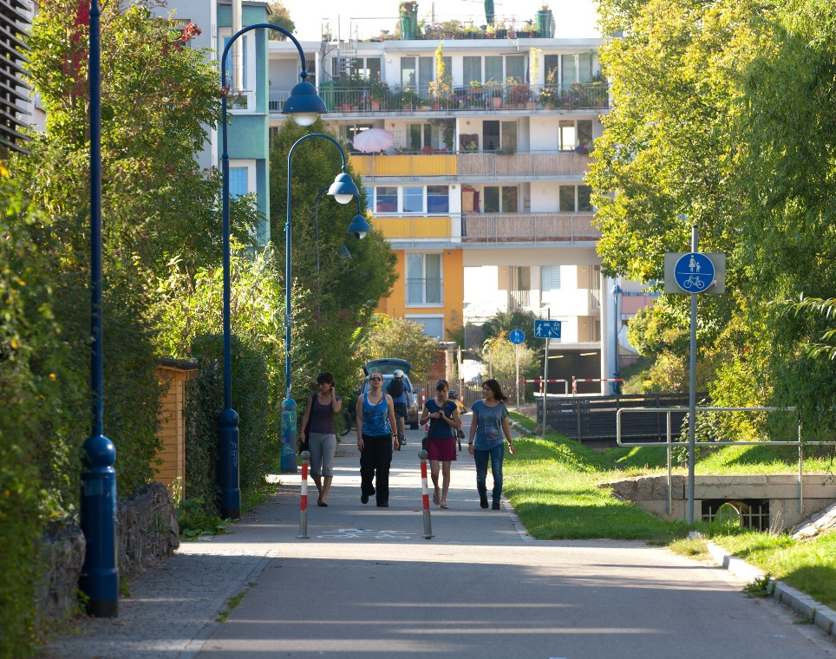
c. Fix maximum car parking allowances – limiting how much parking is provided in new building
Good practice in Freiburg – Vauban:
5.602 inhabitants
2.584 households
1.296 private cars
0,50 cars per household
232 cars per 1000 inhabitants in neighborhood garages
no on-street parking
© Jürgen Gies
A new urban district is planned in Freiburg-Dietenbach for about 10.000 inhabitants. The aim of the planning is high living quality in residential streets with active mobility.
The planned parking ratio is between 0.5 to 0.7 parking spaces per housing unit and will be realized exclusively in neighborhood garages
© Jürgen Gies
© Jürgen Gies
<Event> • <Date> • <Location> • <Speaker>

Slide 31
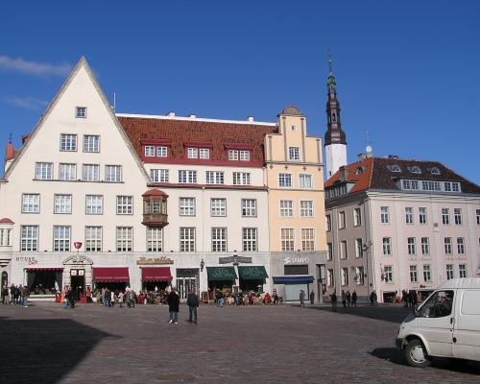
Good practice in Tallinn: Maximum and minimum parking standard
For the inner city a minimum and maximum parking standard set the ratio by 1,2 car parking space per household, no trade off possible
For the suburban areas and outskirts the minimum parking is 1,2 car parking spaces, but the developer can built as much as wanted
Modifications are discussed and standards may change
© Park4SUMP
Tallinn is the capital city of Estonia and the old part has been a UNESCO World Heritage Site since 1997
<Event> • <Date> • <Location> • <Speaker>

Slide 32
Minimum vs Maximum
In high density areas trends are noticeable to switch from minimum to maximum parking norms;
In London the change from minimum to maximum standards took place with the Greater London Development Plan in 1976;
Evidence suggests that minimum parking requirements increase the construction costs of shopping centres, office and residential buildings
<Event> • <Date> • <Location> • <Speaker>

Slide 33
Summary
<Event> • <Date> • <Location> • <Speaker>

Slide 34
To take home!
If the car is the closest means of transport to home and easy to park at the destination, it is usually the first choice.
Creating parking spaces in residential areas lead to the need of more parking space at the workplace, at shopping centers and leisure facilities in addition
Nevertheless, parking standard requirements are important steering instruments for the municipalities and should not be given out of hand
High requirements to build fixed parking standards affected construction and maintenance costs, so parking standards should give the option to lower requirements if transportation alternatives are available
Ideally, maximum car parking allowances are fixed and limit how much parking is provided in new buildings, but it takes some effort to achieve
<Event> • <Date> • <Location> • <Speaker>
Notes:
One of the fields of activities within the Park4SUMP Project is parking standards.
Parking standards are also known as parking requirements or parking norms.
In this training material we focus on parking standards for new developments.
New development is a broad term. It refers to new residential areas, but also to areas with mixed use of residential and commercial space, which is increasingly the focus of new urban expansion projects. Purely commercial areas are not discussed in greater detail for reasons of complexity

Slide 35
Exercise/Workshop
<Event> • <Date> • <Location> • <Speaker>

Slide 36
Please discuss the following topics
Which kind of parking standards do you apply? Why?
Should parking standards be related to (all kinds of) public transport accessibility?
Should there be central government guidance on parking standards?
How do developers respond to constrains on parking provision (max. standards)? Or to obligations (min. standards)?
Do you think off-street parking spaces are shared by more than one user, allowing for more efficient use of parking facilities?
<Event> • <Date> • <Location> • <Speaker>

Slide 37
Thank you!
<Speaker>
Contact Details
<Organization>
<Address>
<e-Mail>
http://www.civitas.eu

